Slide 1

Workshop: Scalable Machine Learning with H2O
Jo-fai (Joe) Chow
Data Scientist
joe@h2o.ai
@matlabulous
satRday #1
MTA TTK, Budapest, Hungary
3rd September, 2016

Slide 2
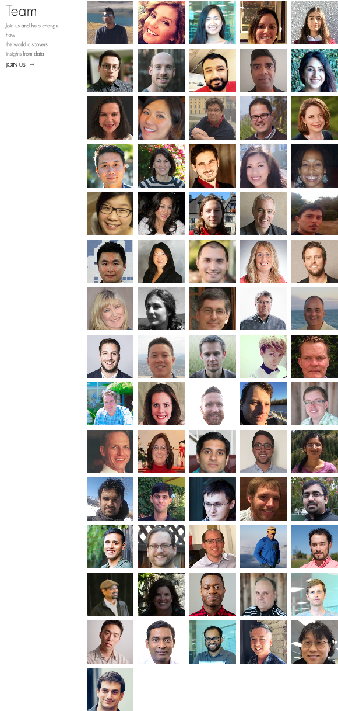
About H2O.ai
H2O.ai, the Company
Team: 80 (71 shown)
Founded in 2012,
HQ: Mountain View, California
H2O, the Platform
Open Source (Apache 2.0)
R, Python, Scala, Java and Web Interfaces
Distributed Algorithms that Scale to Big Data
Works with Laptop, Hadoop & Spark
Jakub
(Kuba)
Joe
Notes:
Team is growing rapidly
Based in Mountain View – I am the only guy in UK/Europe
VC: $34M in total

Slide 3
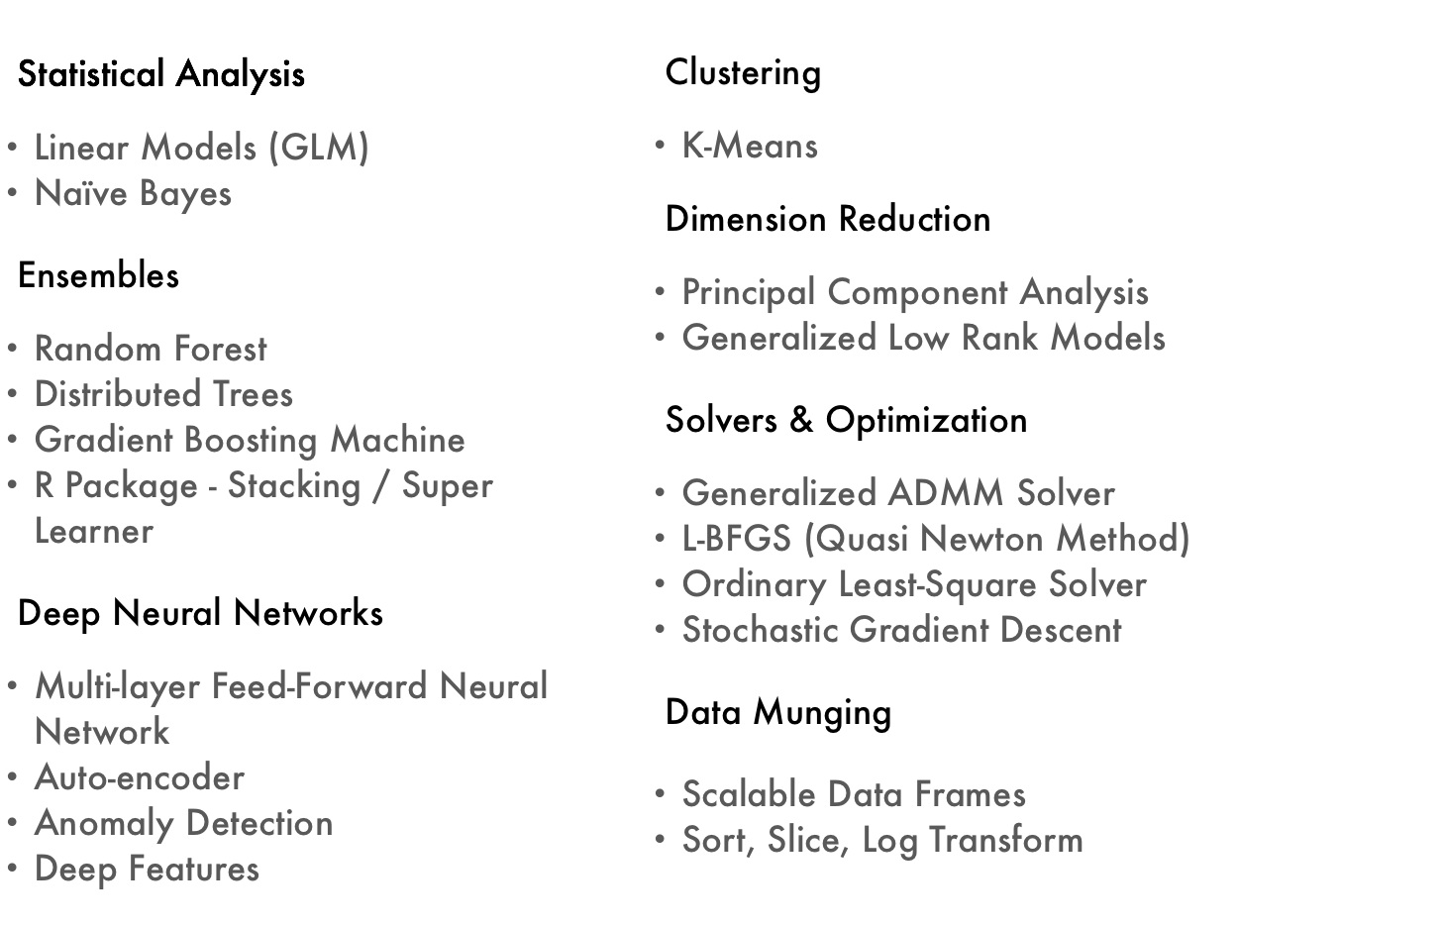
Current Algorithm Overview
Today’s
Workshop

Slide 4
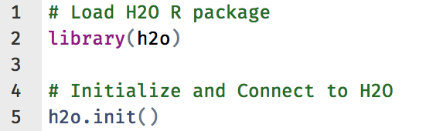
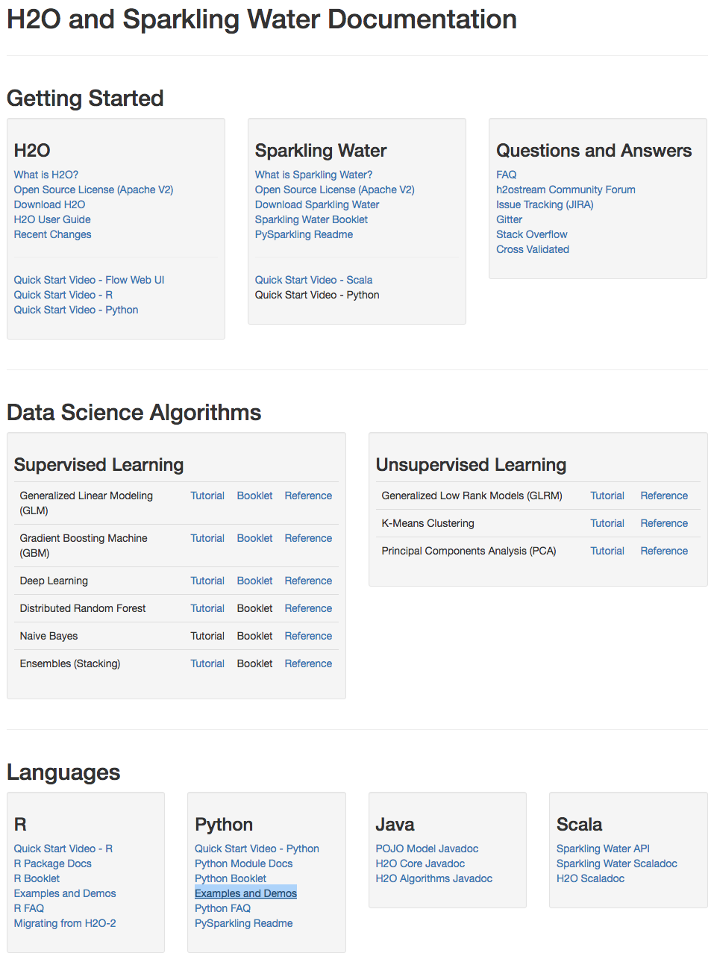
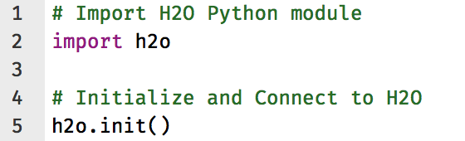
H2O Interfaces – R, Python & Others
R
Python
Resources - docs.h2o.ai

Slide 5
About this Workshop
Basics (steps 1 – 6)
Loading data
Training basic models
Manual tuning
Advanced (steps 7 – 9)
Grid search
Random grid search
Model stacking
Scalable ML
Today’s workshop
Small dataset
Local H2O cluster (single laptop)
To scale it up
Change one line of code - connect to bigger H2O clusters (AWS, Hadoop, Spark etc.)
Rest of code remains the same

Slide 6
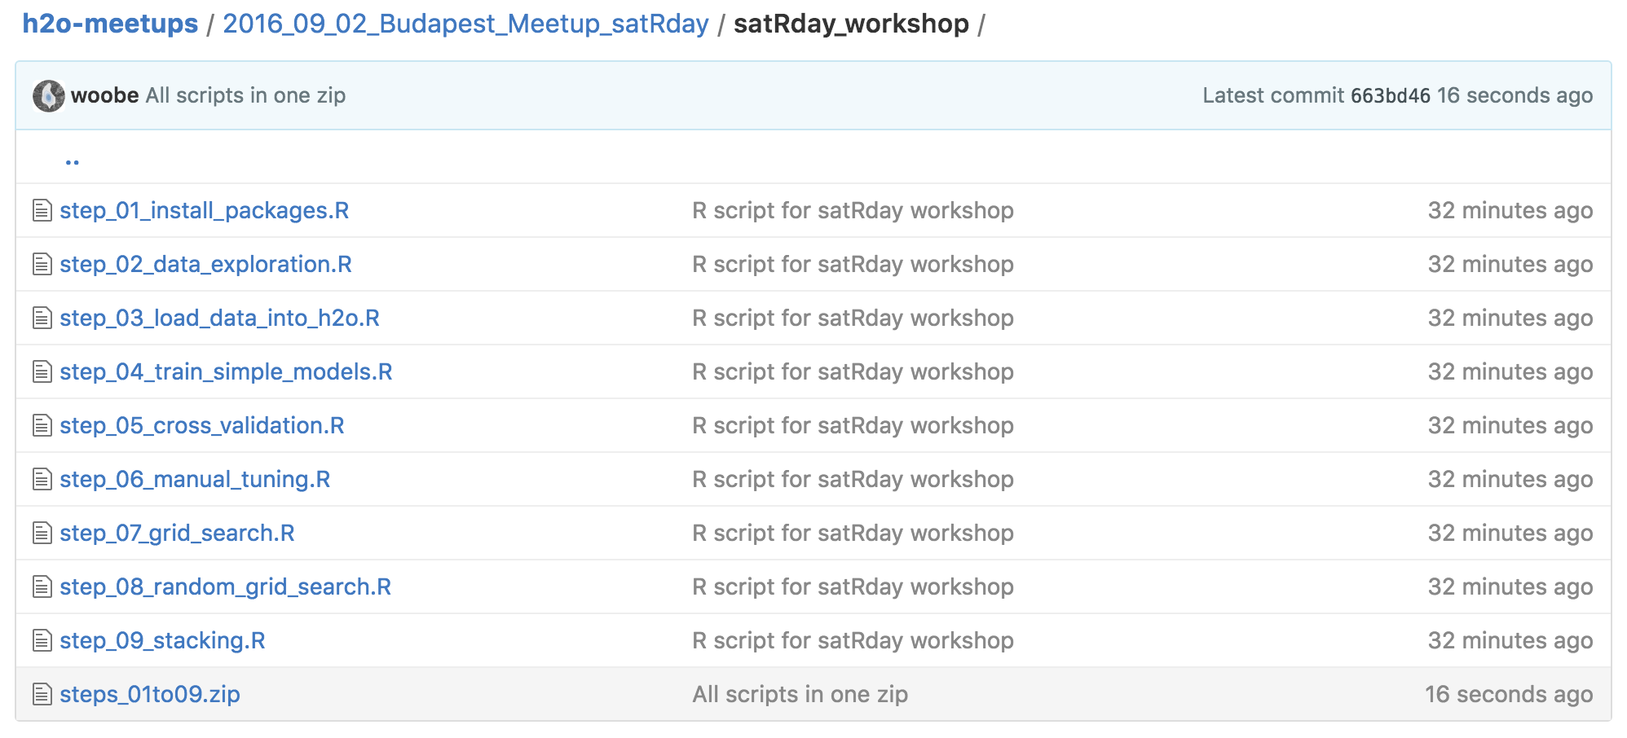
Download R Scripts for Workshop
Please go to bit.ly/h2o_budapest_workshop
(WIFI Password: Bp+2016.09.03)
Download this
Zip file

Slide 7
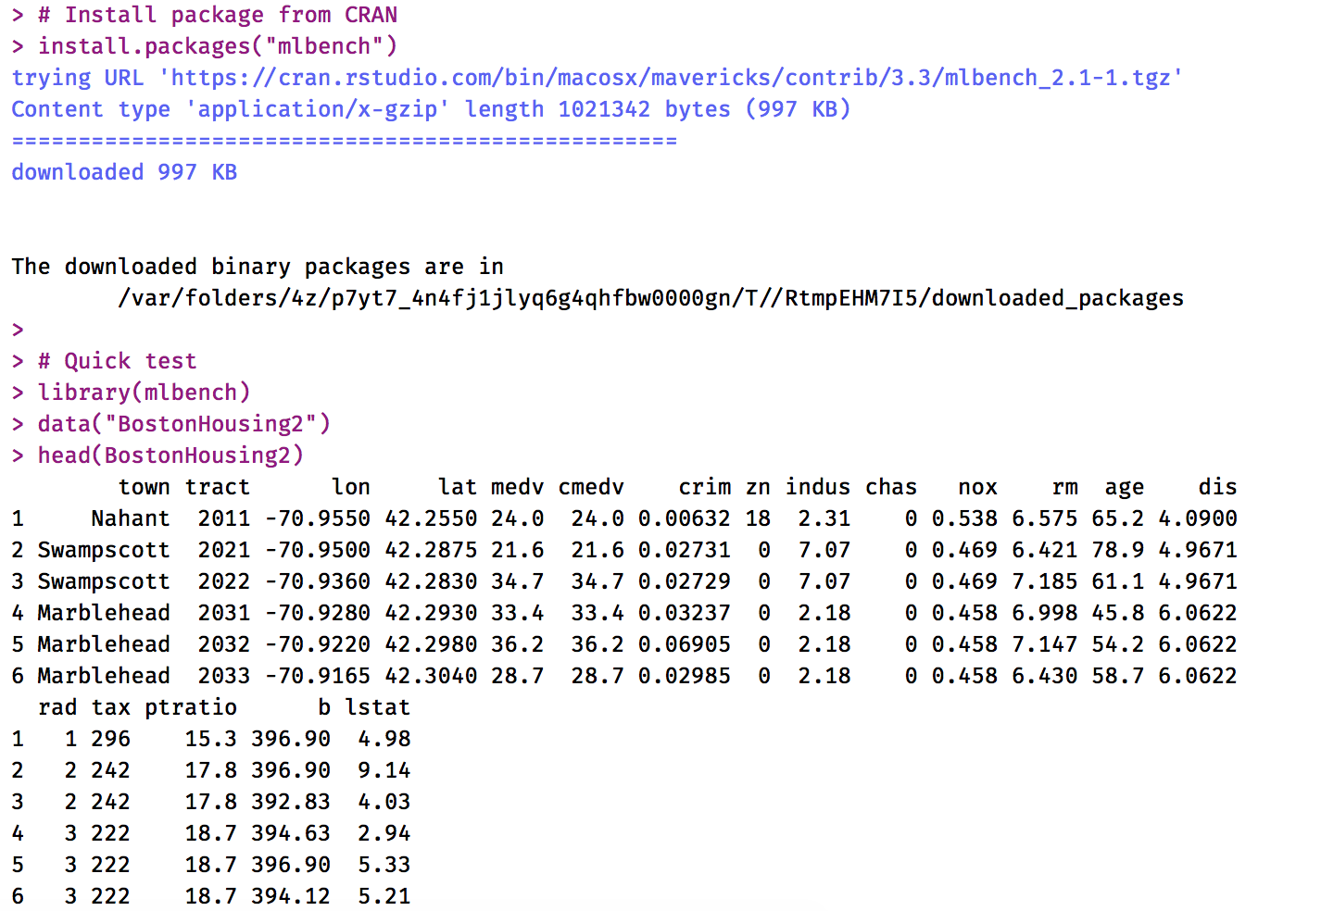
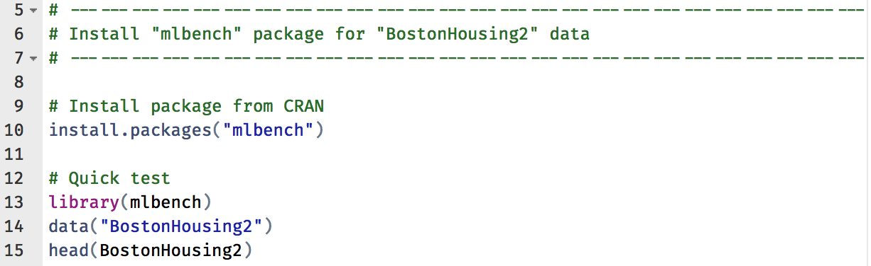
step_01_install_packages.R
Package ‘mlbench’

Slide 8
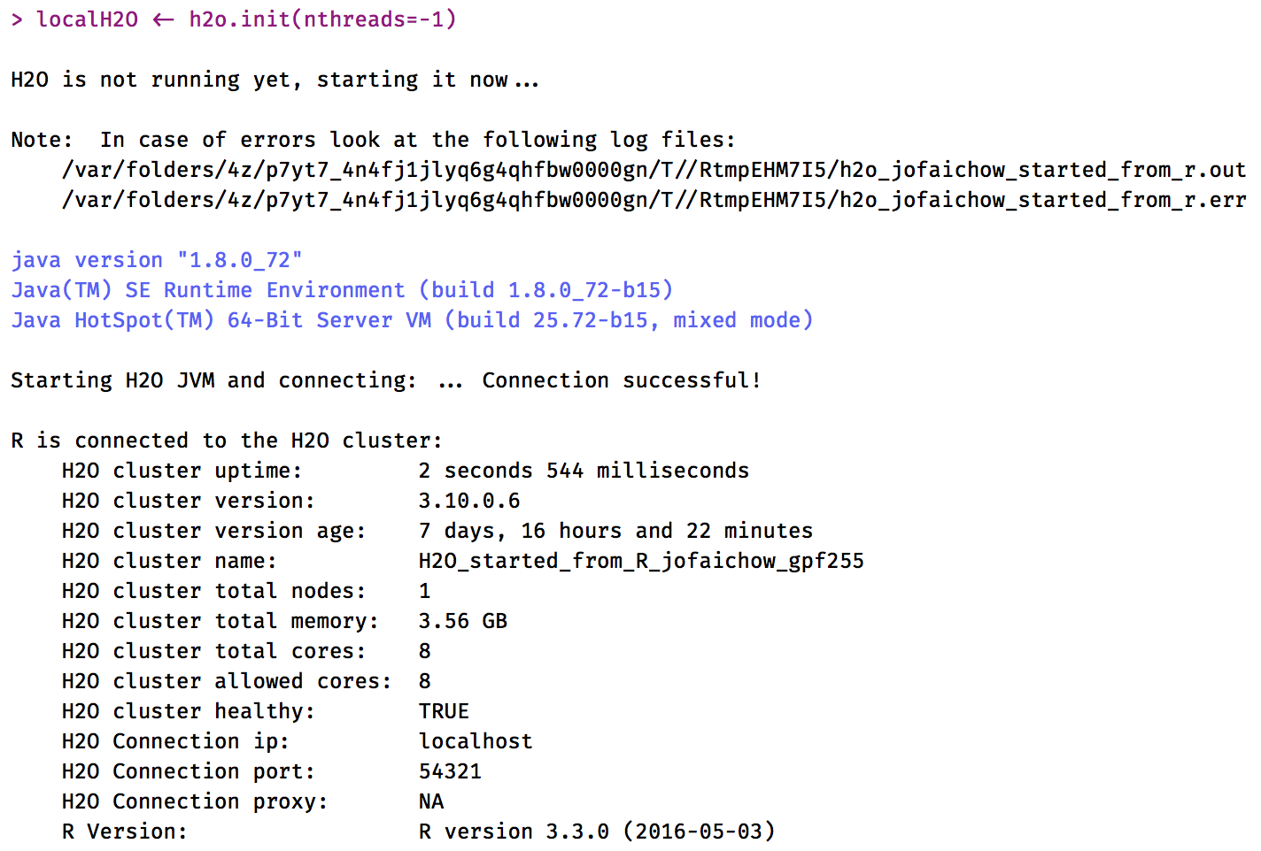
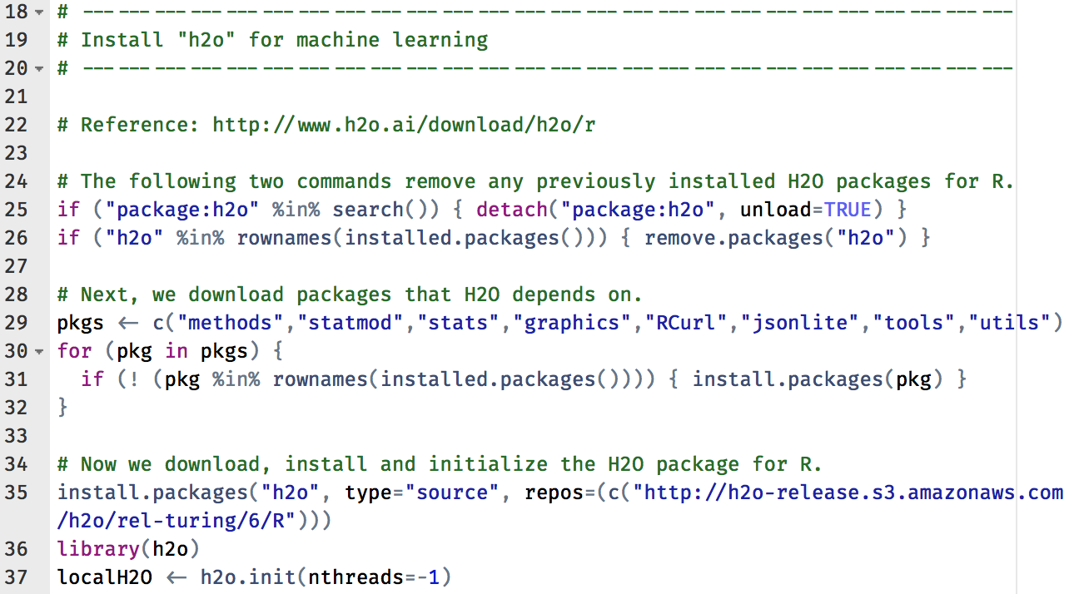
step_01_install_packages.R
Package ‘h2o’

Slide 9
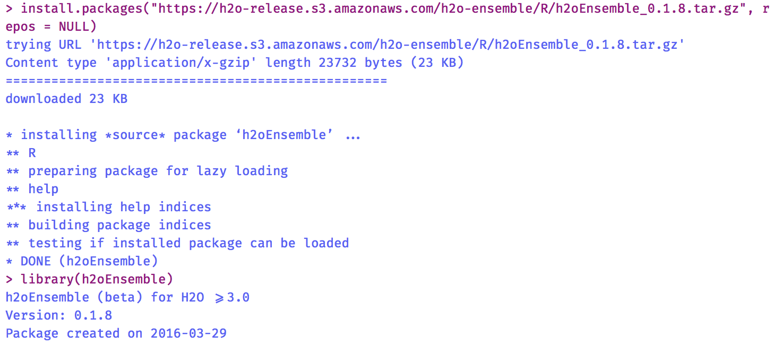
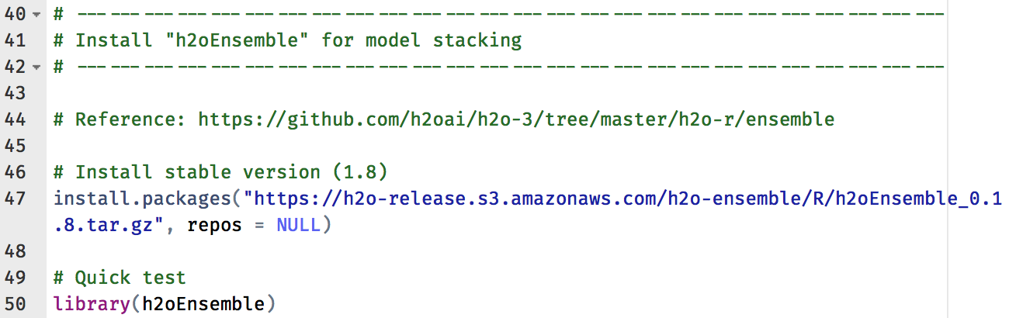
step_01_install_packages.R
Package ‘h2oEnsemble’

Slide 10
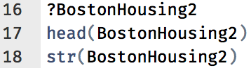
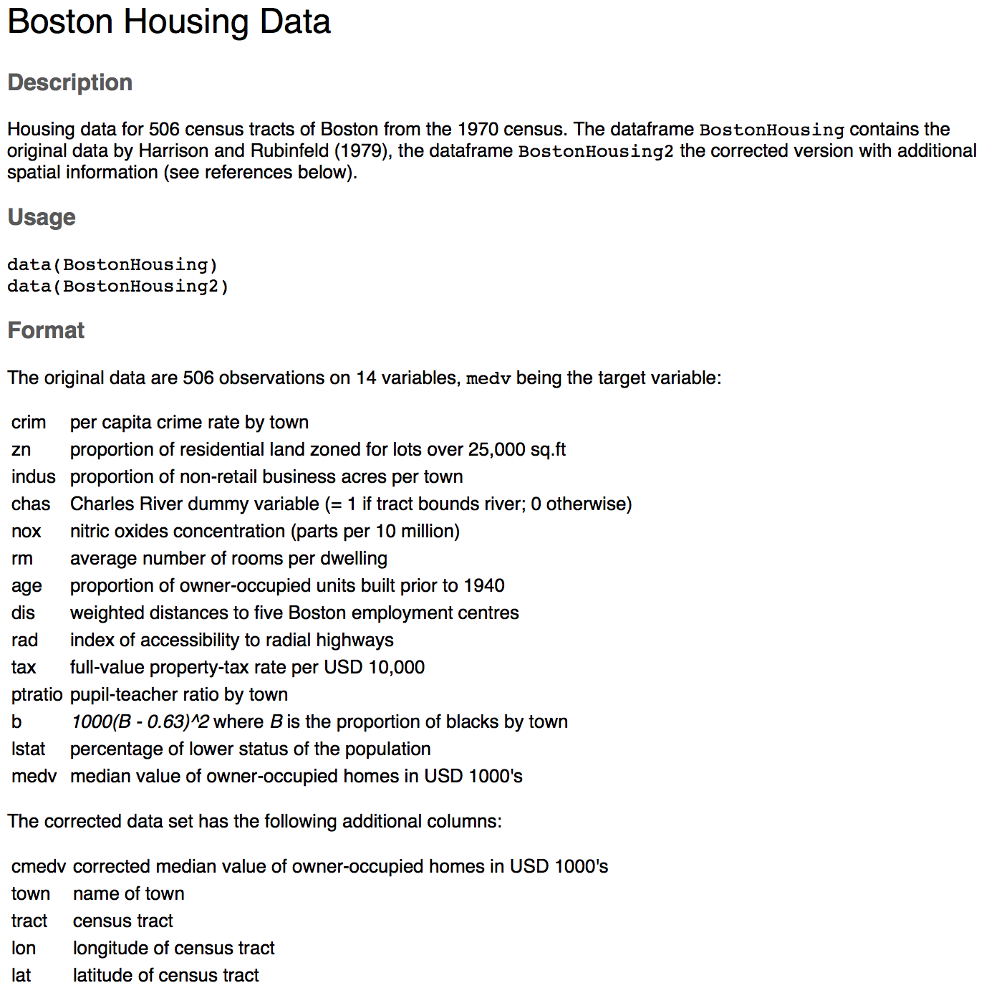
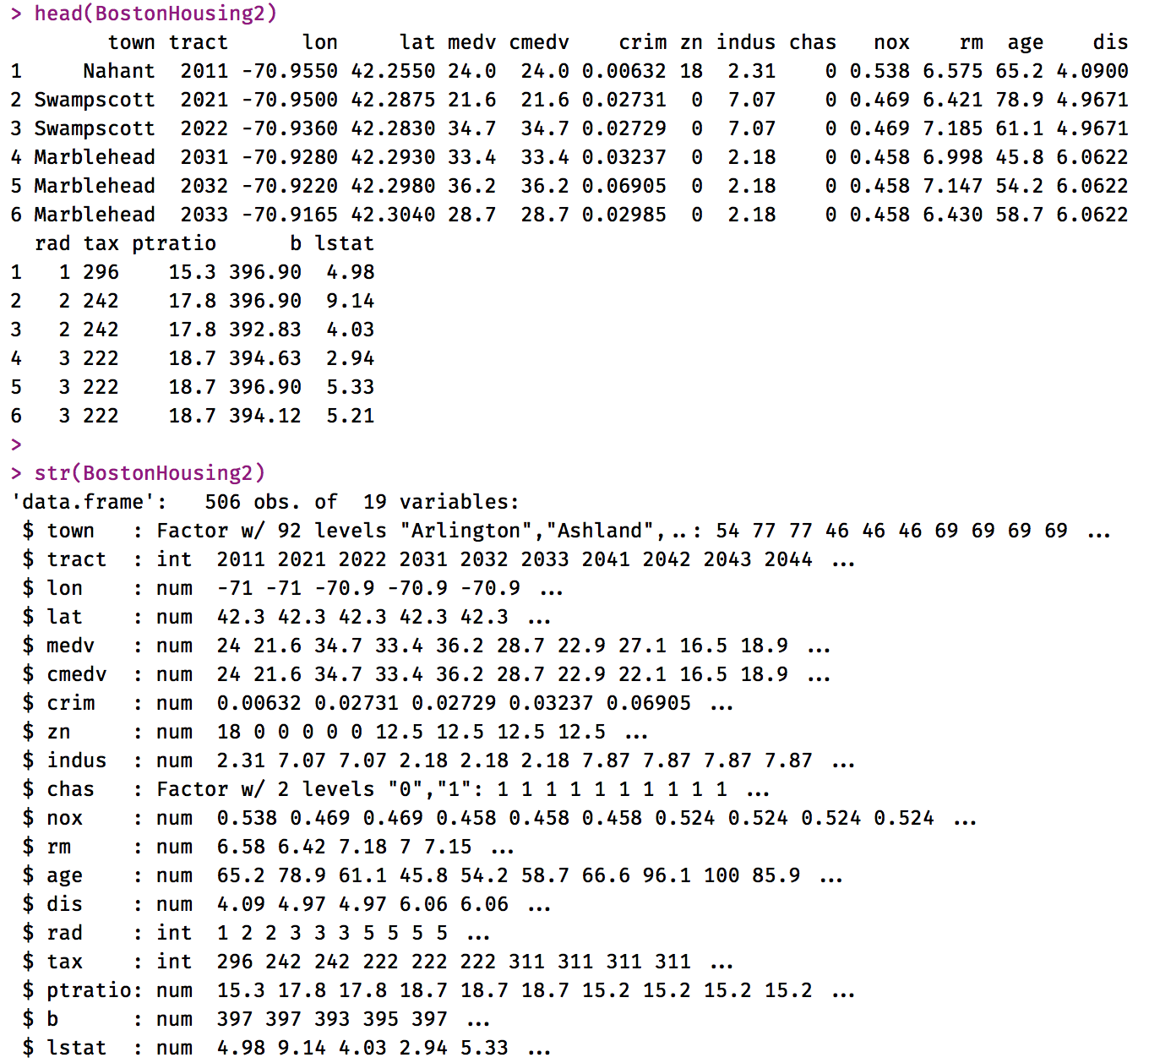
step_02_data_exploration.R

Slide 11
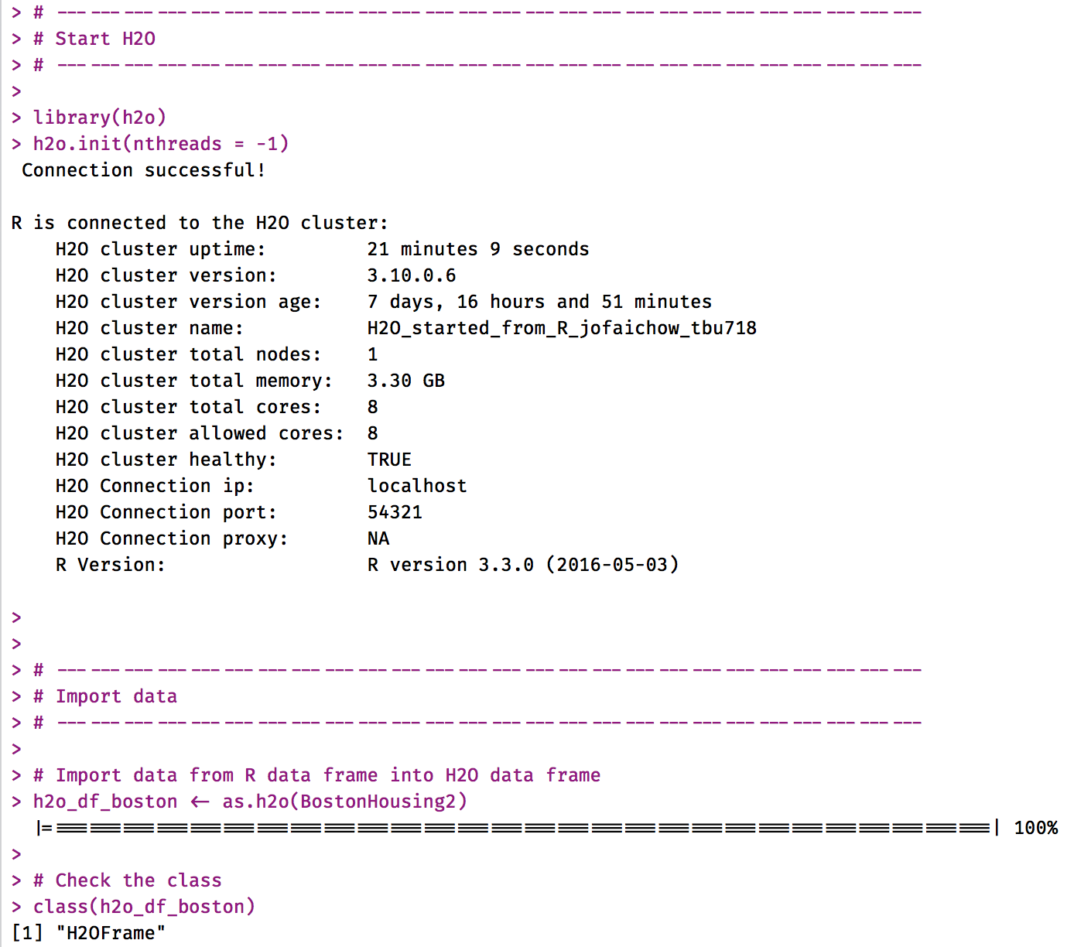
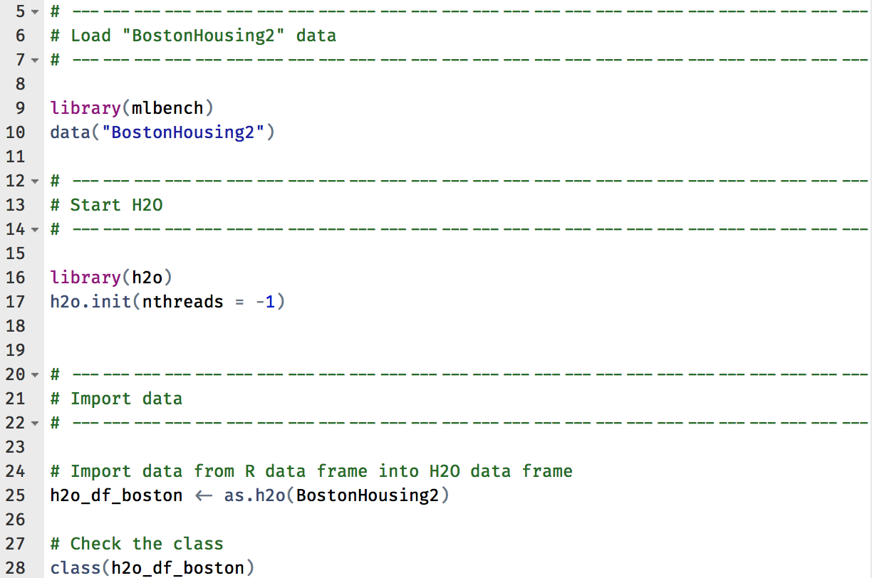
step_03_load_data_into_h2o.R

Slide 12
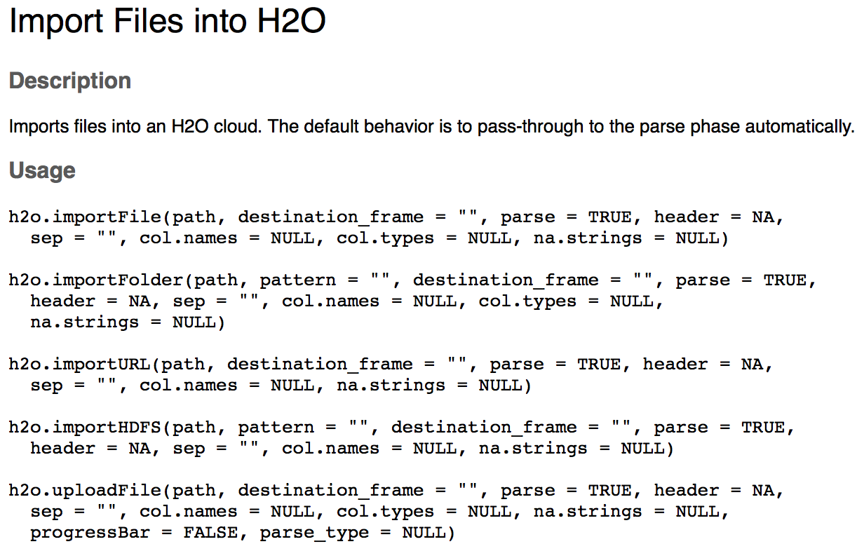
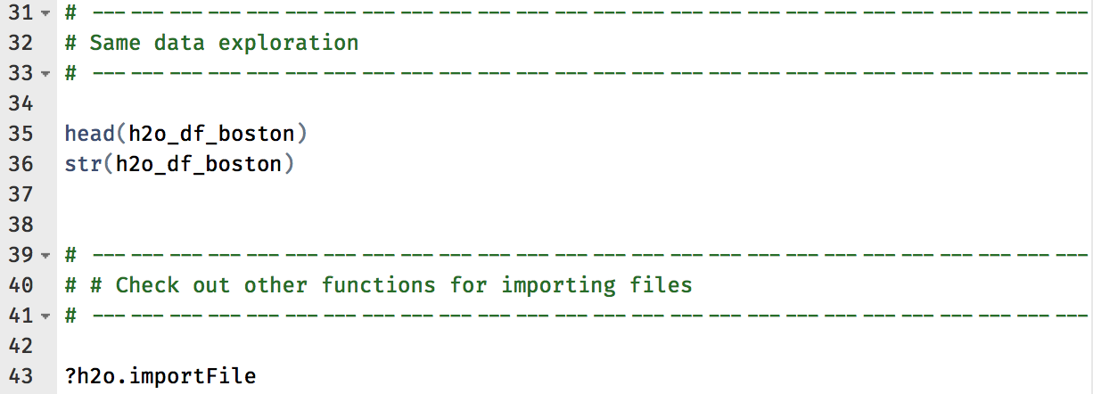
step_03_load_data_into_h2o.R
Check out other import functions later

Slide 13
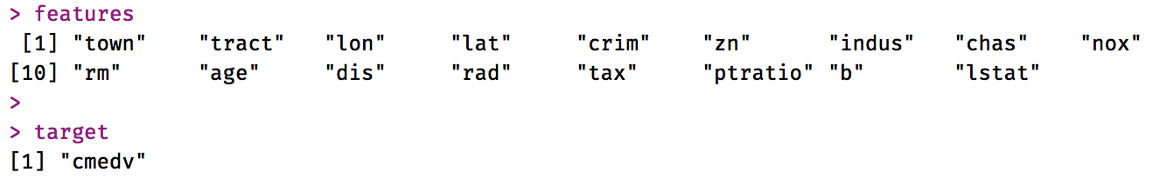
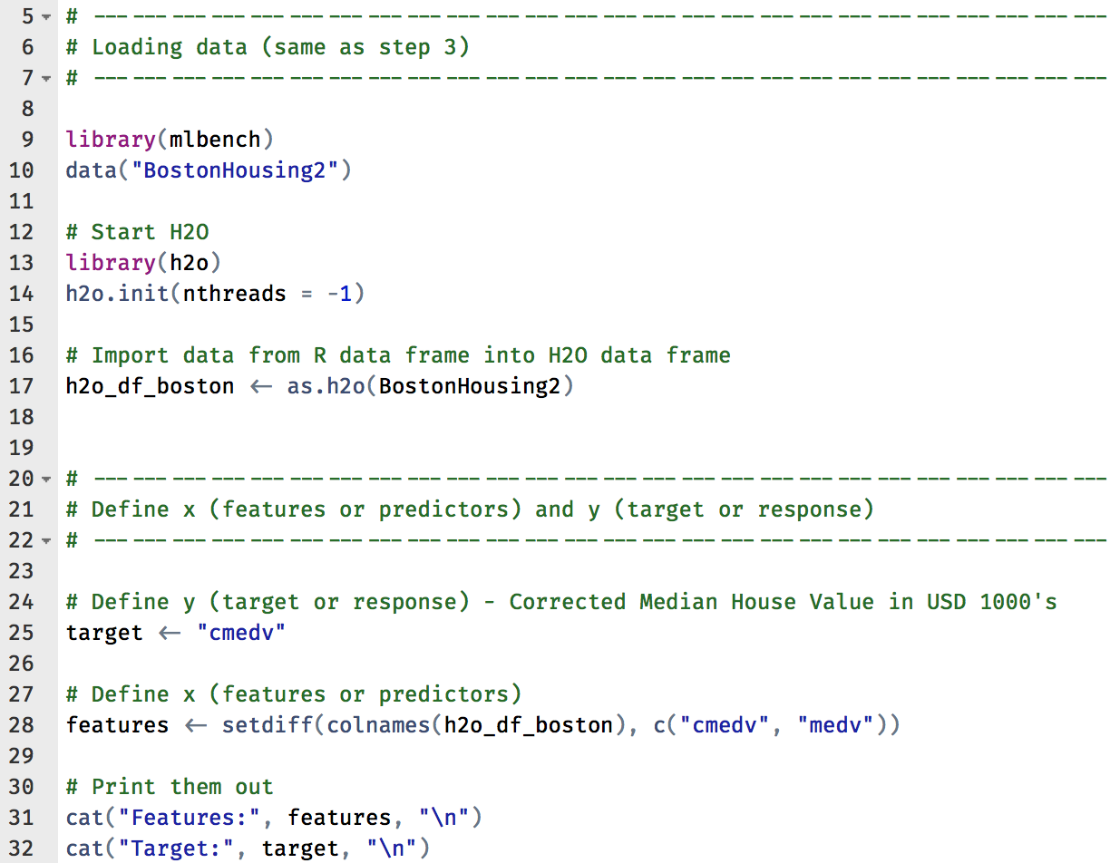
step_04_train_simple_models.R

Slide 14
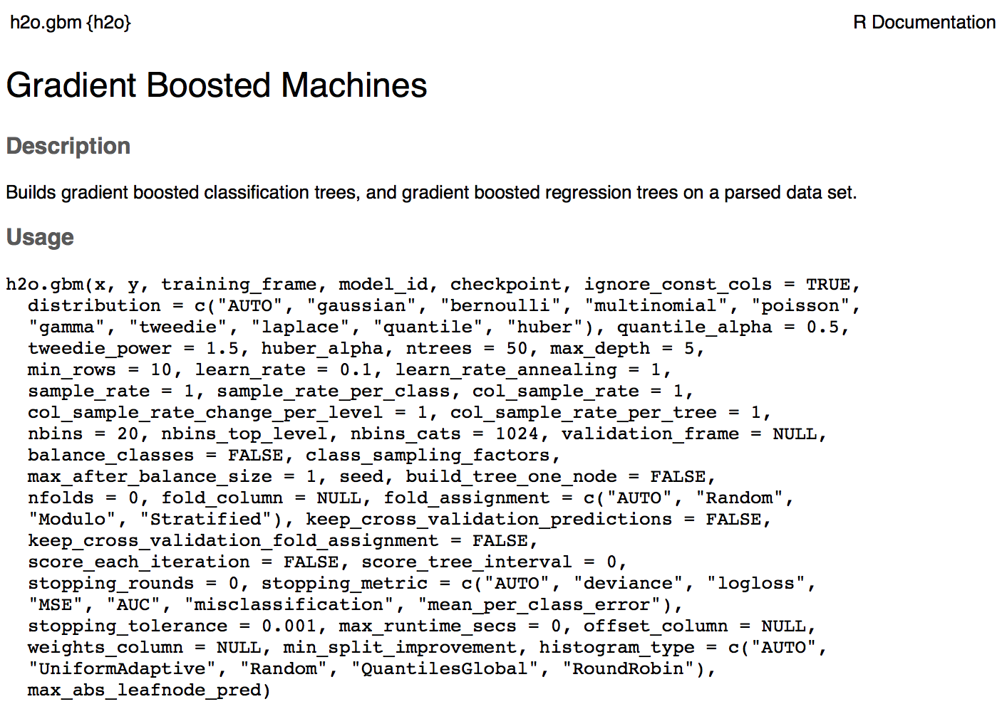
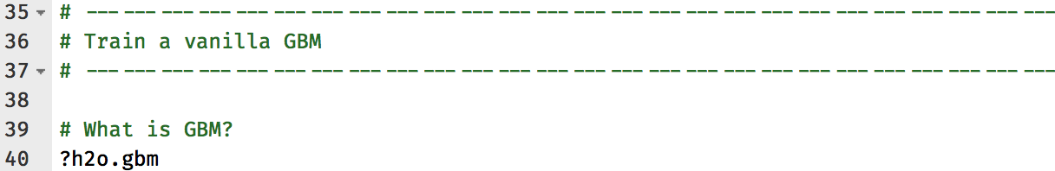
step_04_train_simple_models.R
Look at available parameters in H2O GBM

Slide 15
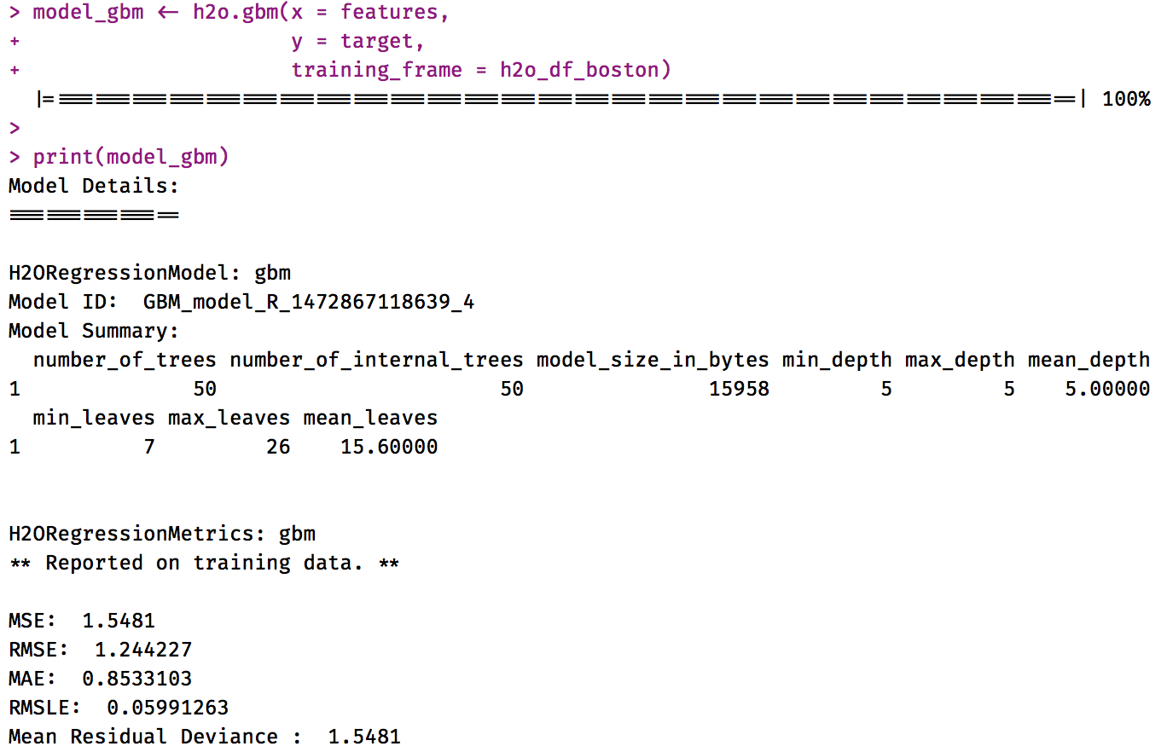
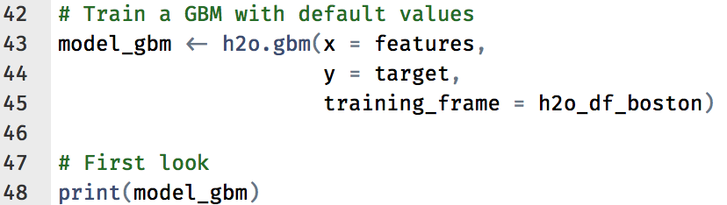
step_04_train_simple_models.R
Using default values

Slide 16
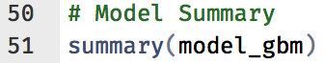
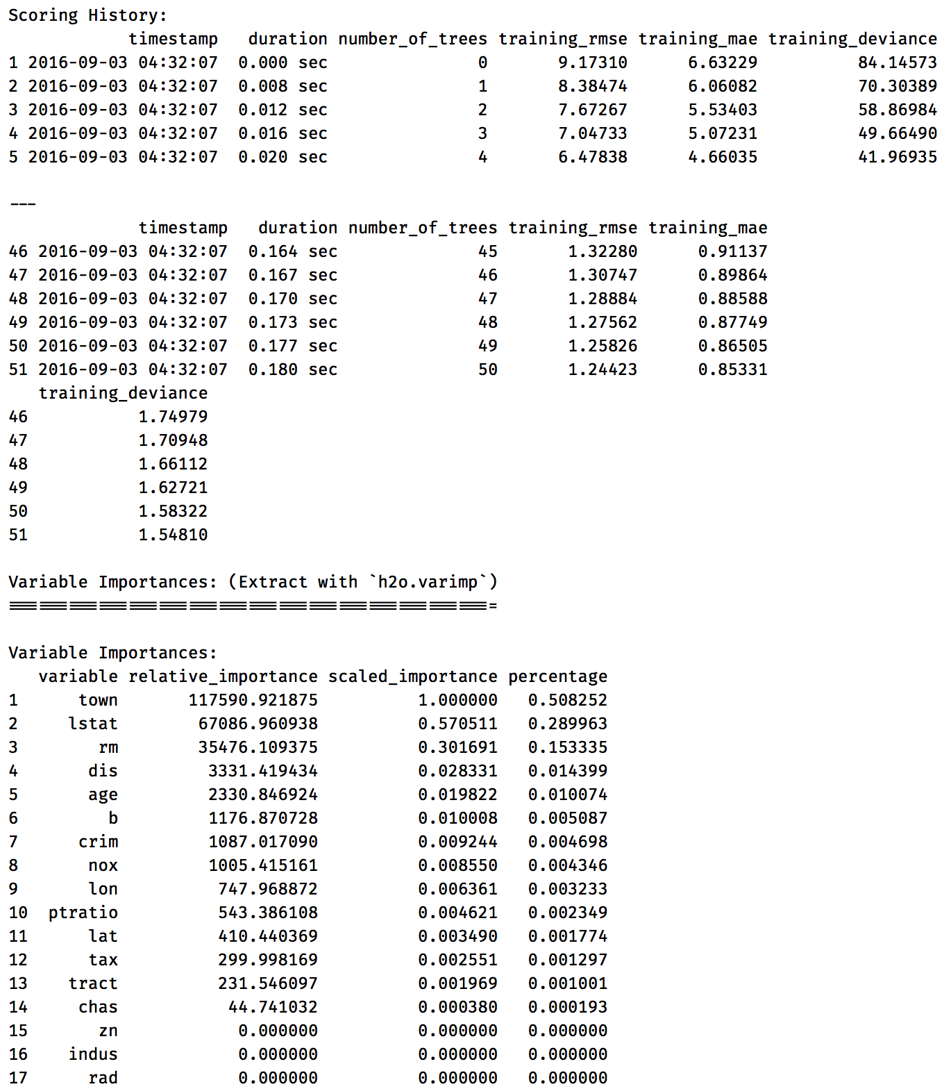
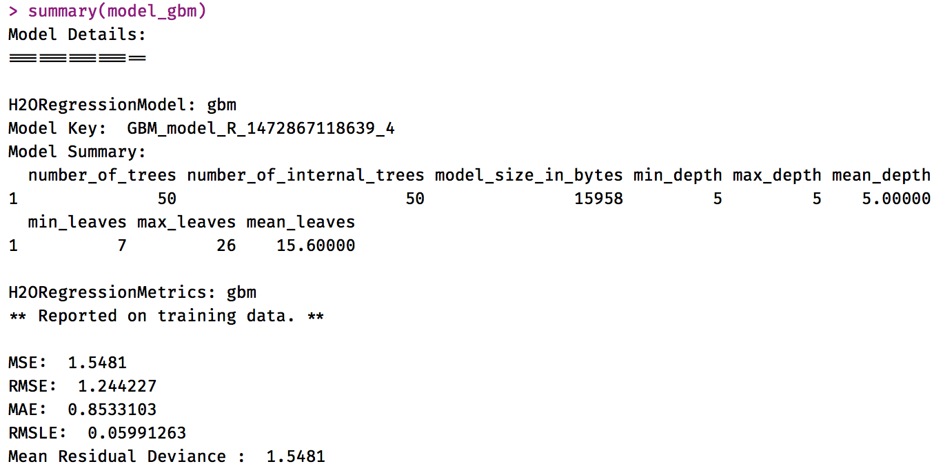
step_04_train_simple_models.R

Slide 17
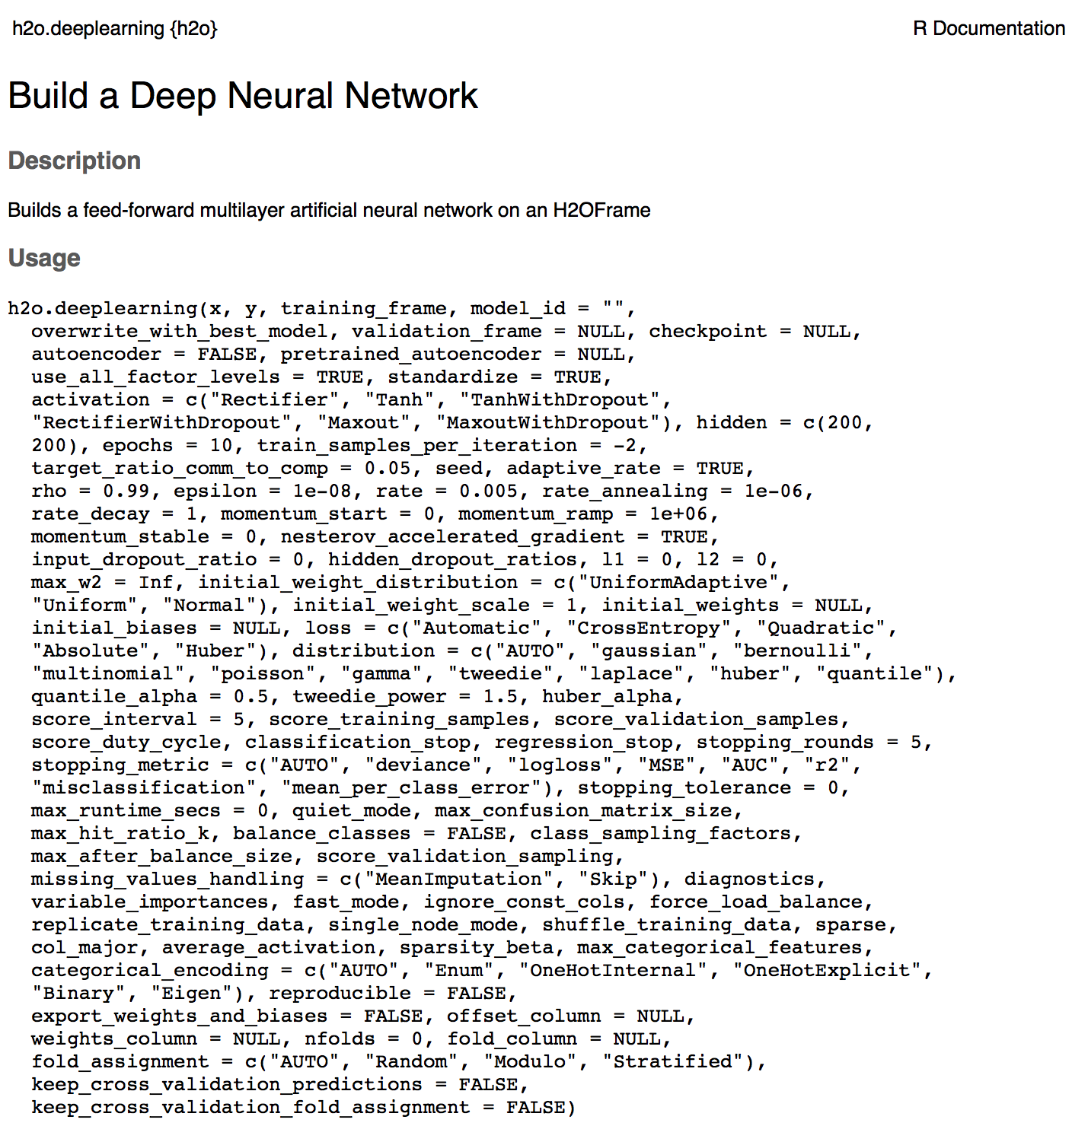
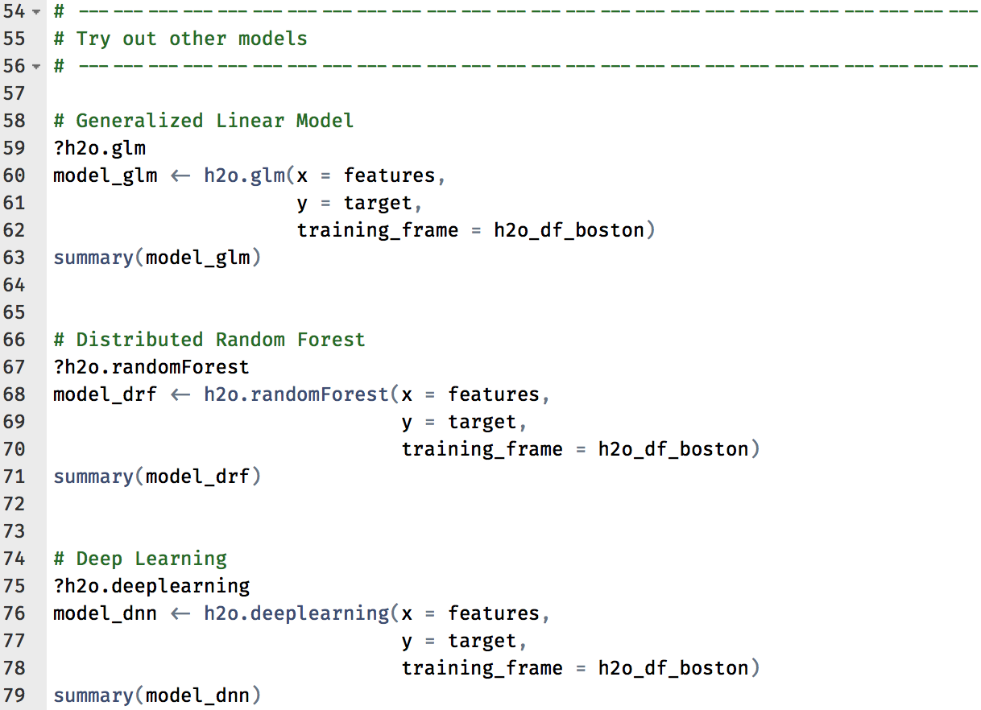
step_04_train_simple_models.R

Slide 18
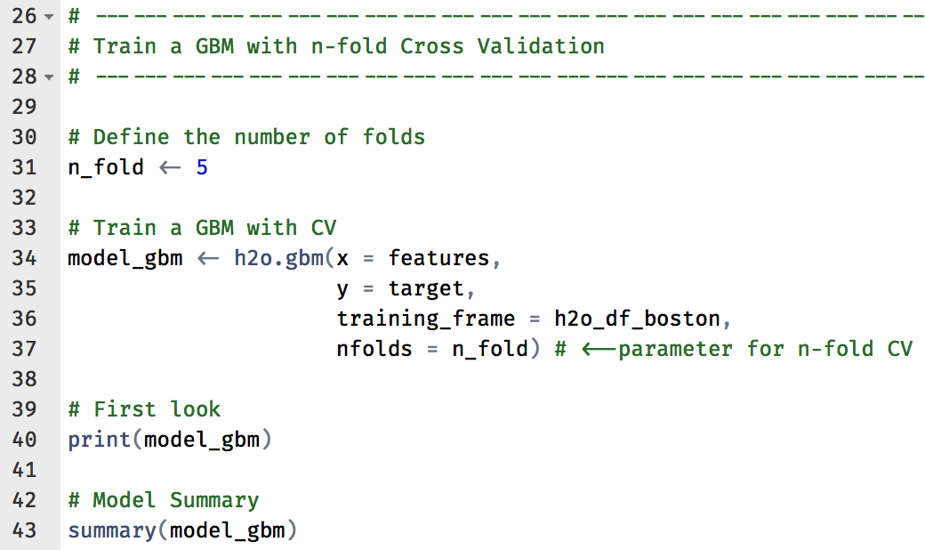
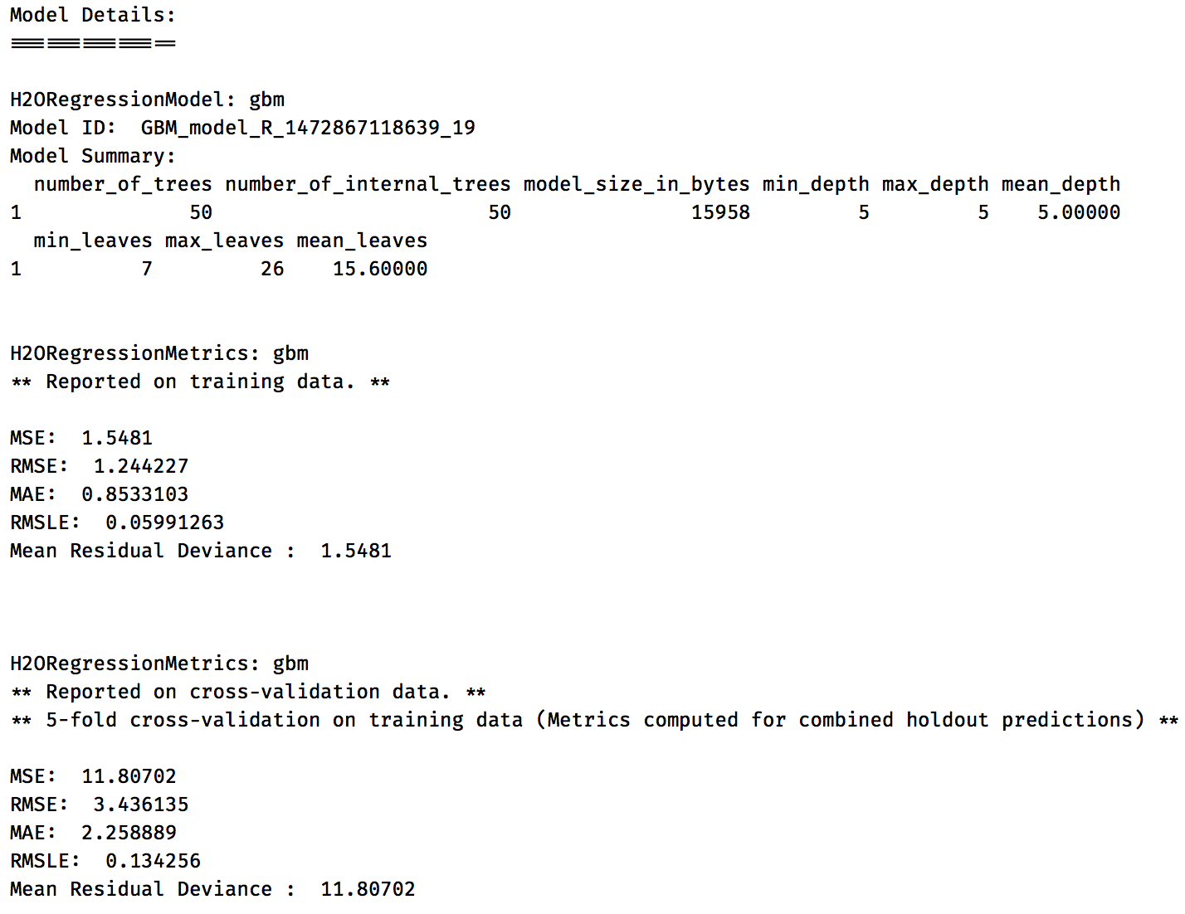
step_05_cross_validation.R
Problems with
Overfitting

Slide 19
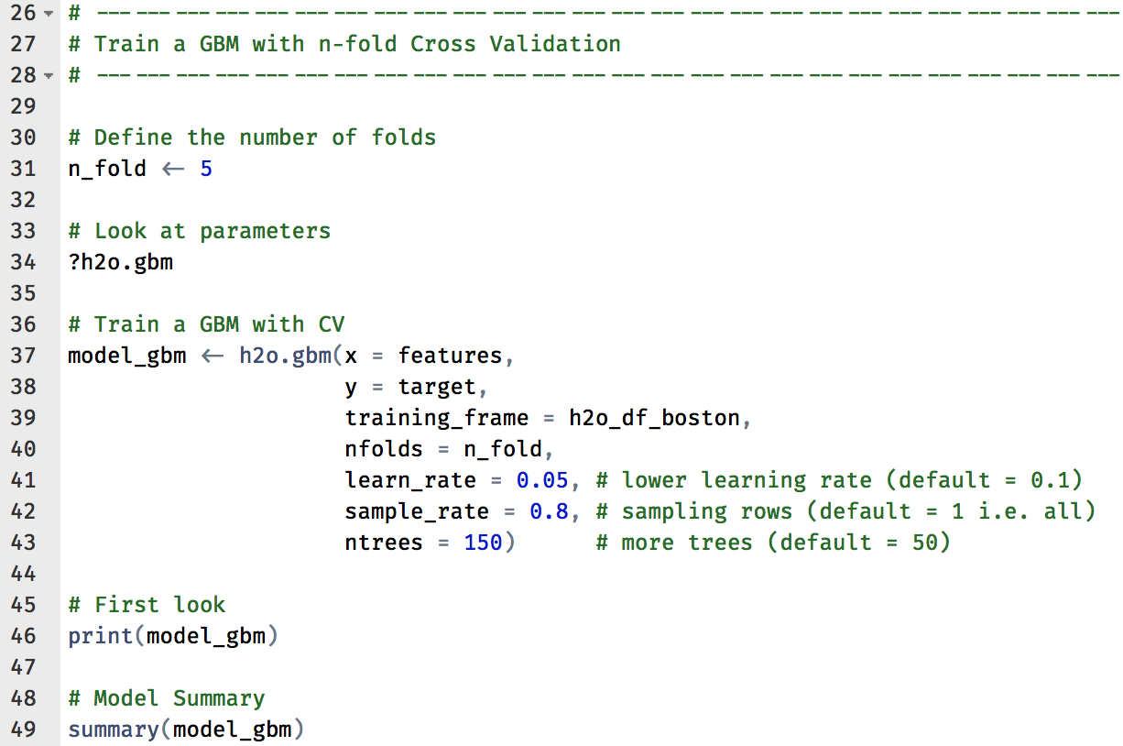
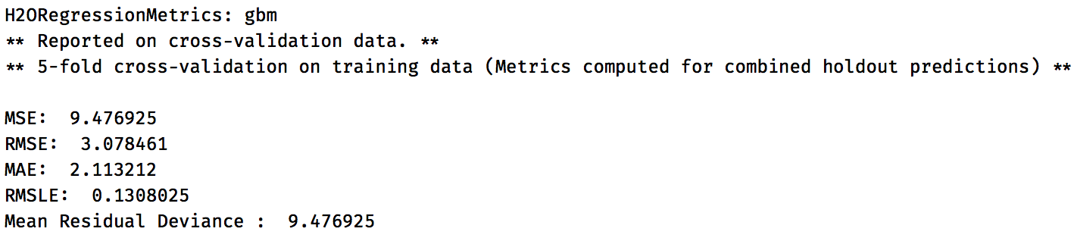
step_06_manual_tuning.R
Try to avoid overfitting with manual tuning
Using default values
Manual tuning –
Slightly better

Slide 20
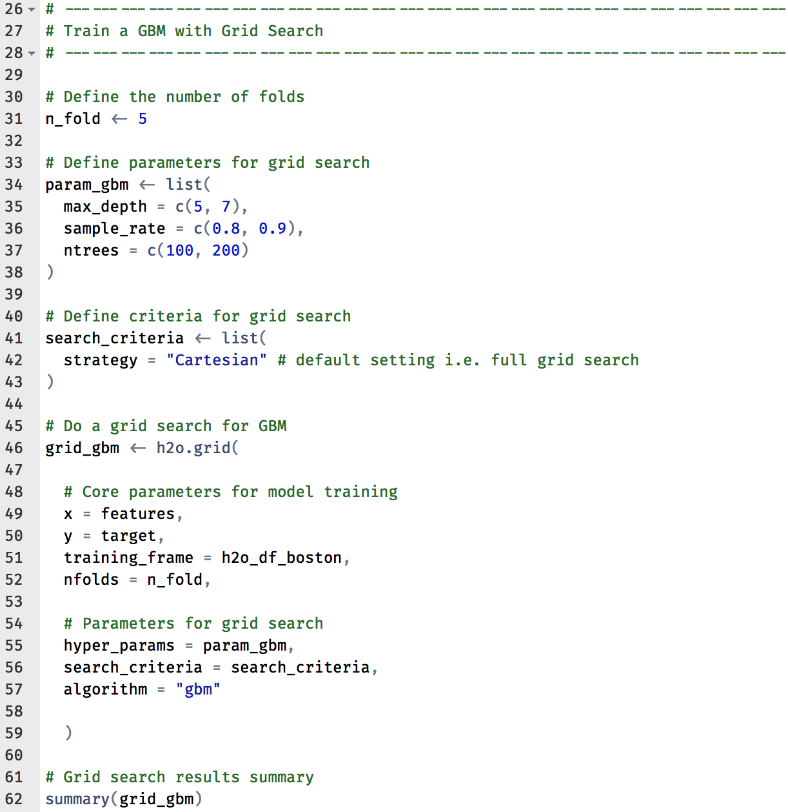
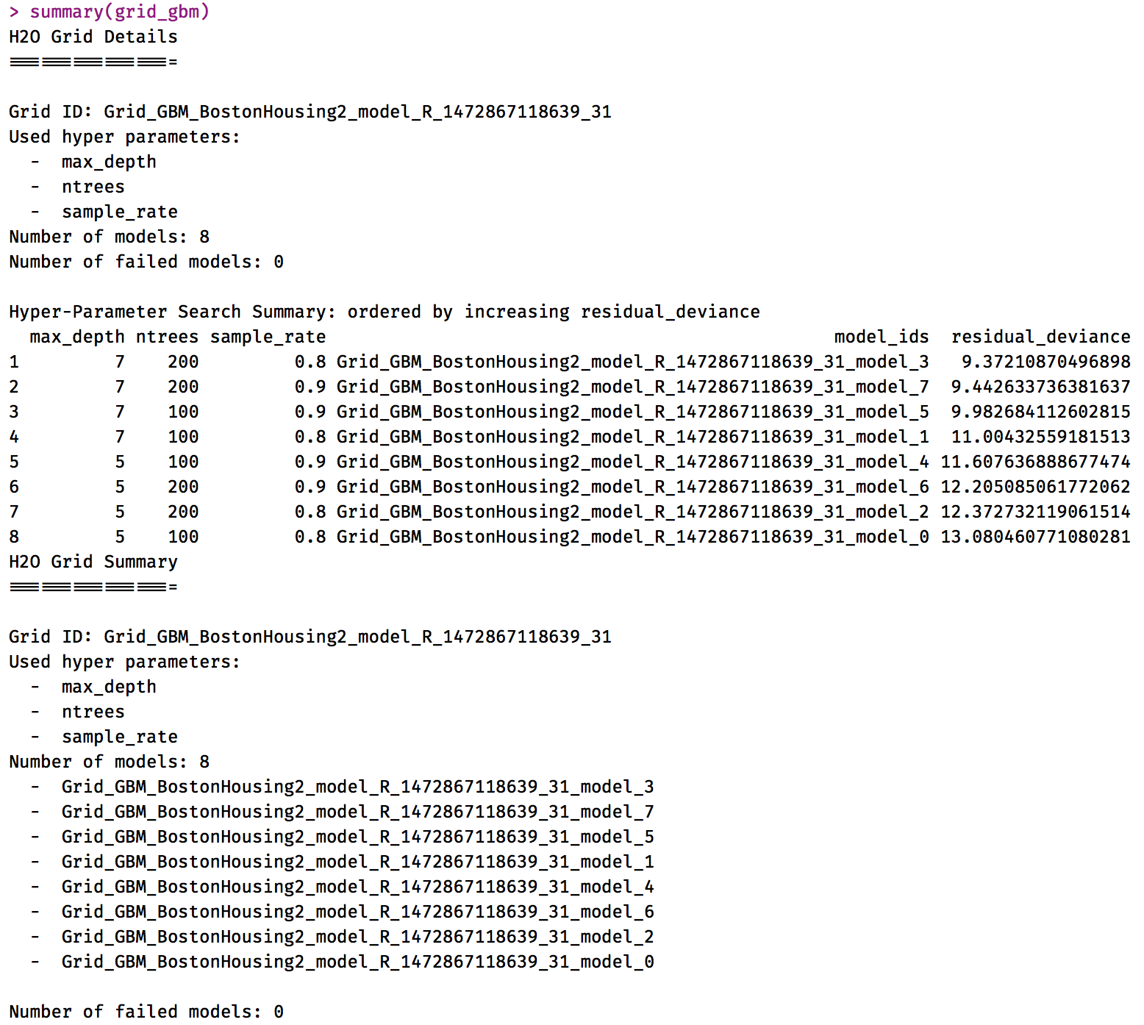
step_07_grid_search.R
Using H2O to find best parameter settings
2x2x2 = 8 models

Slide 21
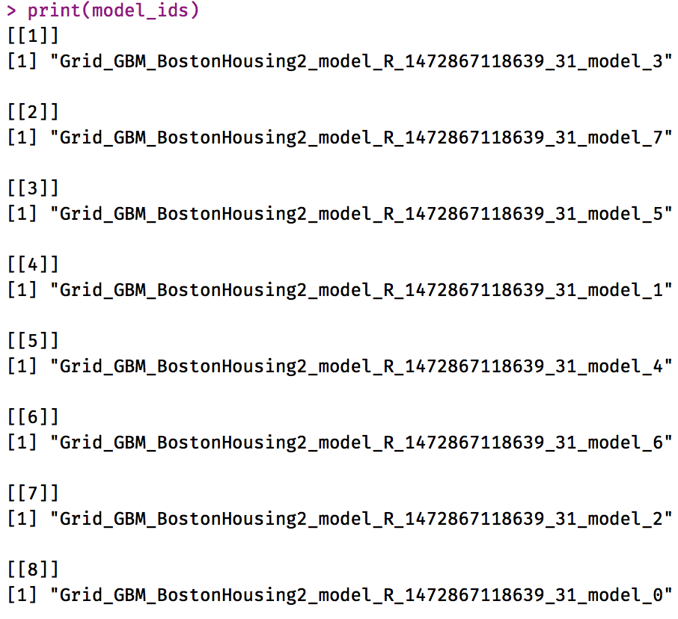
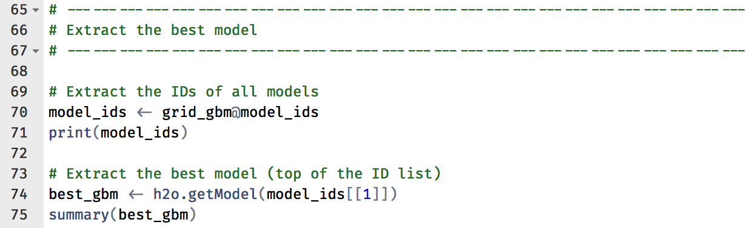
step_07_grid_search.R
Extract the best model

Slide 22
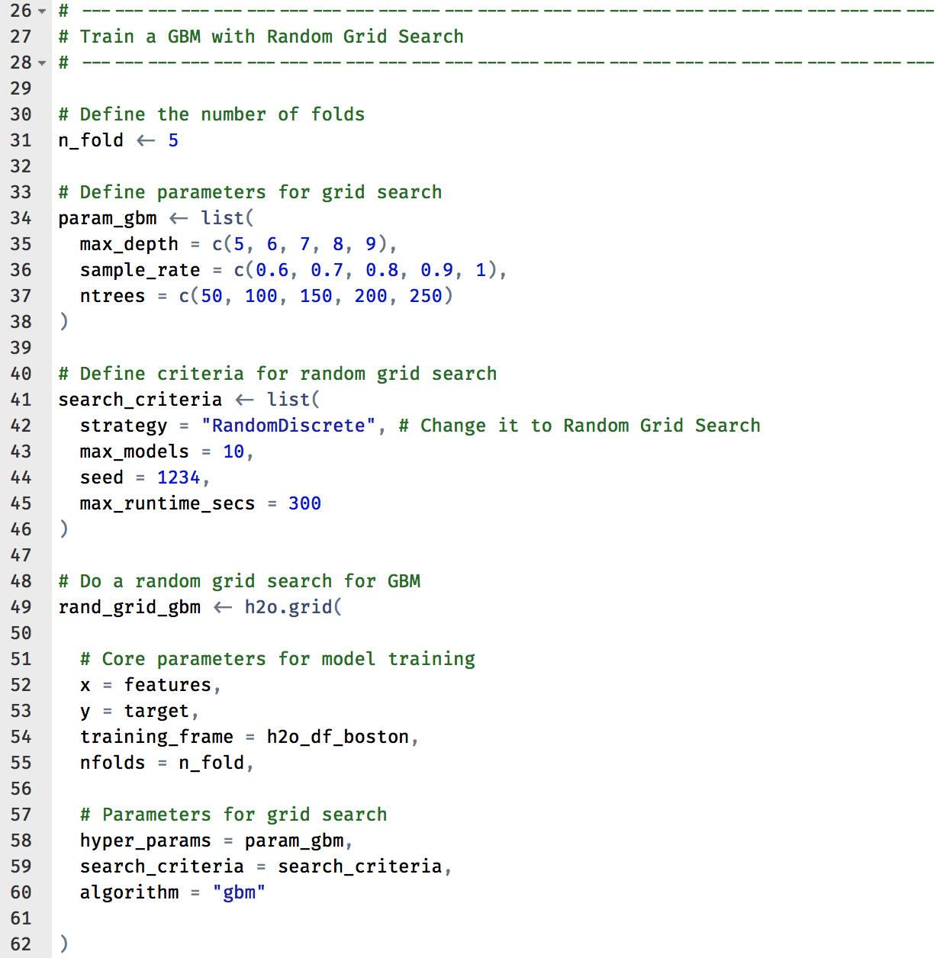
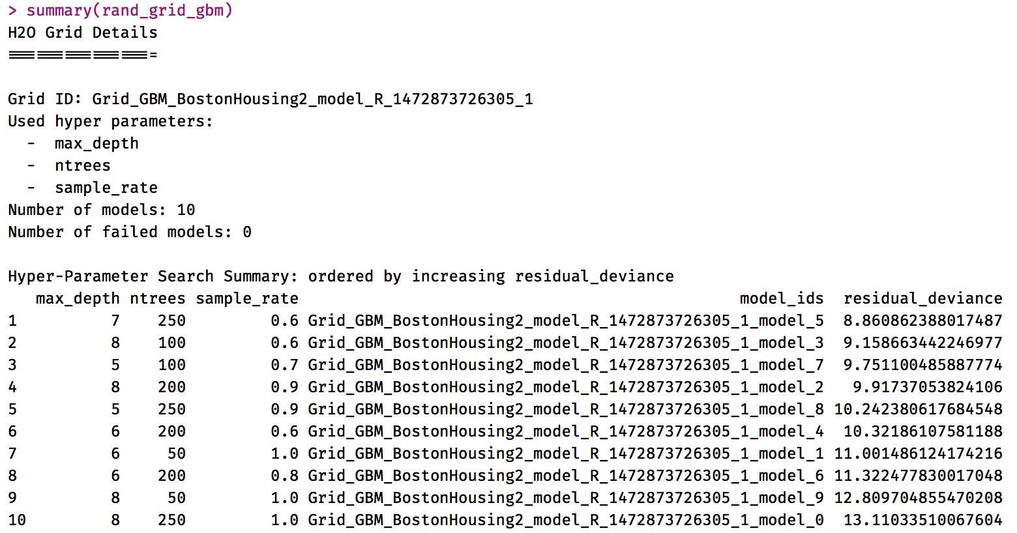
step_08_random_grid_search.R
What if I want to expand the search space?
5x5x5 = 125 models
define max runtime /
no. of models

Slide 23
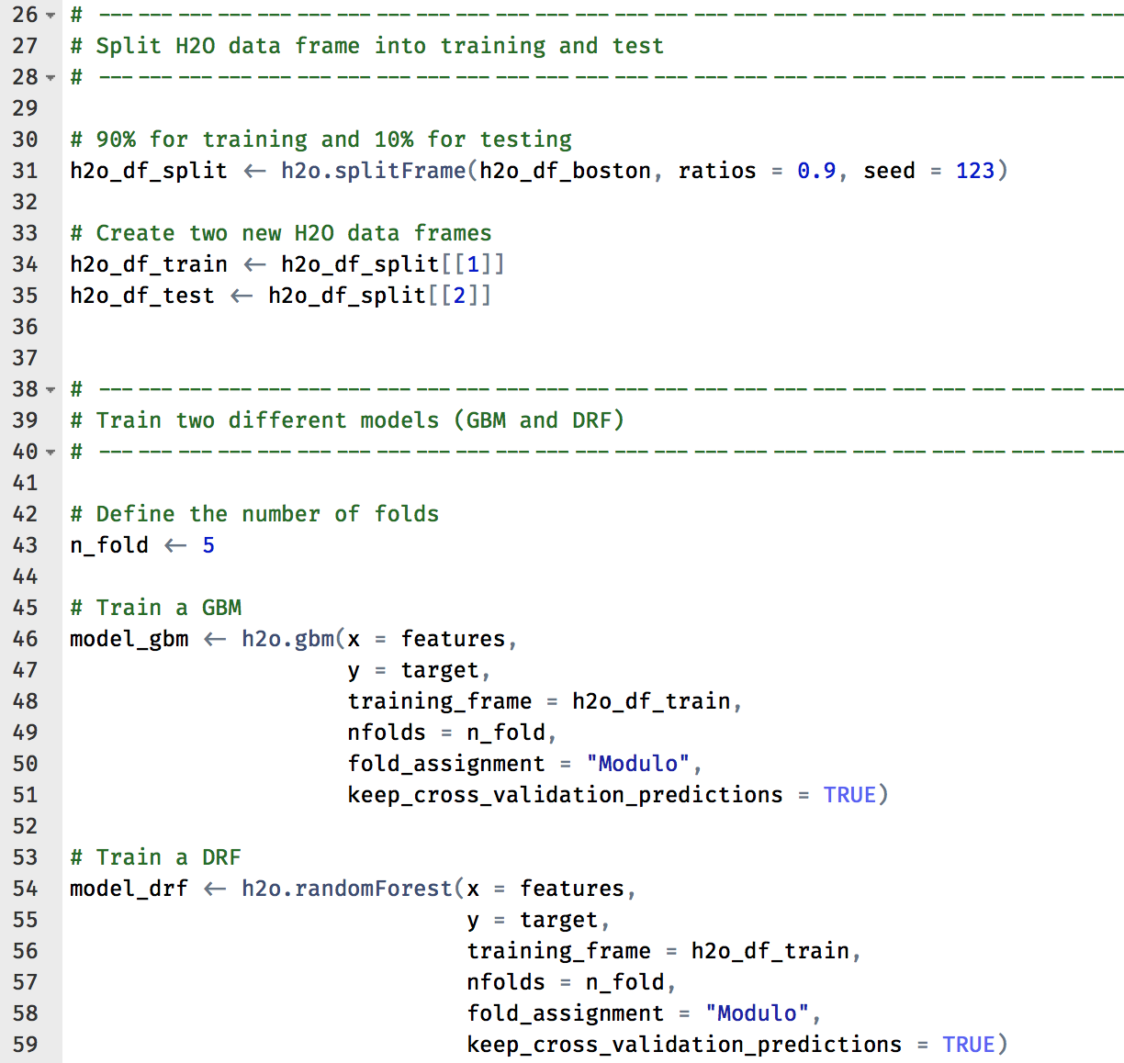
step_09_stacking.R
Why?
Ensembles perform better than individual base algorithms
See “Intro to Practical Ensemble Learning” by Erin LeDell

Slide 24
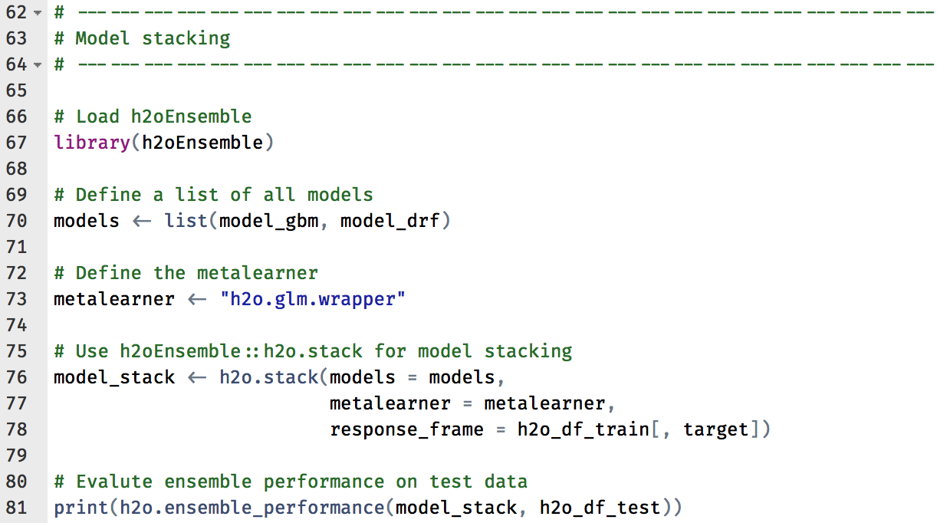
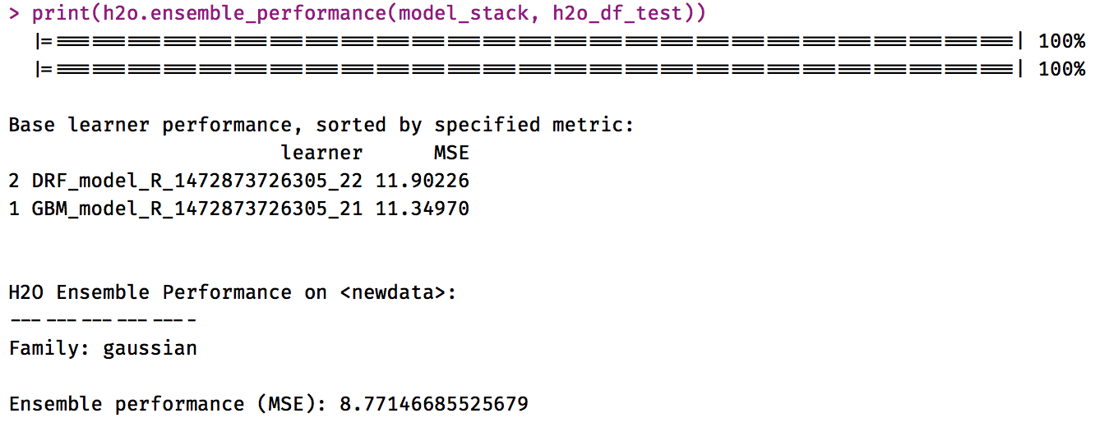
step_09_stacking.R

Slide 25
Other Advanced Topics
Random Grid Search + Model Stacking
Saving / Loading Models
Exporting Plain Old Java Objects (POJOs)
Resources
docs.h2o.ai
Contact
joe@h2o.ai
@matlabulous

